Slide 1
Project Management
Foundations & An Introduction

Slide 2
About projects..

Slide 3
We’ve all handled a project in one form or another…
Large scale complex requirements
Short term assignments
$
$$$$
1 week
> 10 years
Fix your cabinet
Develop an ERP System

Slide 4
But what is a project?
A project has certain characteristics…
a one time effort
having defined starting and end dates
having a specified objective and scope of work to be performed
producing a unique product or service
solving a problem or addressing a need
having a set budget
usually being performed by a temporary organization
Being led by one ultimately accountable individual (PROJECT MANAGER)

Slide 5
But when doing any project, we always encounter a dilemma
Cost
Performance
Time
Scope
C = f(P,T,S)
So we need to manage the project well

Slide 6
What is Project Management?
The selection, design (planning, scheduling), execution, control, evaluation, and termination of a project to meet project objectives and customer expectations within allocated cost, time, resource, and performance constraints (Keating, 1998).
“Project management is the art of creating the illusion that any outcome is the result of a series of predetermined, deliberate acts when, in fact, it was dumb luck.” (Kerzner, 1998)
SCIENCE
ART

Slide 7
What is Project Management?
“Project Management is the planning, scheduling and controlling of project activities to achieve project objectives.” (Lewis 1995)
“PM is the planning, organizing, directing, and controlling of company resources for a relatively short-term objective that has been established to complete specific goals and objectives.” (Kerzner, 1998)
Project management is “the application of knowledge, skills, tools and techniques to project activities to meet project requirements” (PMBOK® Guide, Fourth Edition, 2008, p. 6)

Slide 8
A lot of people want their project to be…
FAST
CHEAP
GOOD
“Fast, cheap and good!
but you can only have 2!”

Slide 9
That’s because of the triple constraint…
Time
Scope
Cost
IRON TRIANGLE

Slide 10
The Quadruple Constraint
Quality
Time
Scope
Cost
Warning: Quality has many definitions

Slide 11
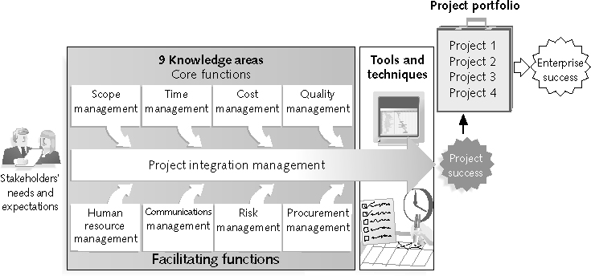
When doing Project Management, there is a proposed framework
Notes:
Stakeholders are the people involved in or affected by project activities
Stakeholders include:
The project sponsor
The project manager
The project team
Support staff
Customers
Users
Suppliers
Opponents to the project
Knowledge areas describe the key competencies that project managers must develop
4 core knowledge areas lead to specific project objectives (scope, time, cost, and quality)
4 facilitating knowledge areas are the means through which the project objectives are achieved (human resources, communication, risk, and procurement management
1 knowledge area (project integration management) affects and is affected by all of the other knowledge areas
All knowledge areas are important!
Project management tools and techniques assist project managers and their teams in various aspects of project management
Some specific ones include:
Project charter, scope statement, and WBS (scope)
Gantt charts, network diagrams, critical path analysis, critical chain scheduling (time)
Cost estimates and earned value management (cost)
“Super tools” are those tools that have high use and high potential for improving project success, such as:
Software for task scheduling (such as project management software)
Scope statements
Requirements analyses
Lessons-learned reports
Tools already extensively used that have been found to improve project importance include:
Progress reports
Kick-off meetings
Gantt charts
Change requests

Slide 12
Let’s look at PM in 1994
31% Critical Failures
53%
Challenged
16%
Success
Not even completed
Typically 189% over budget
Finished!
Source: CHAOS Report 1995 by the Standish Group
Access it here: http://net.educause.edu/ir/library/pdf/NCP08083B.pdf
Notes:
Source: CHAOS Report 1995 by the Standish Group
Access it here: http://net.educause.edu/ir/library/pdf/NCP08083B.pdf
Since 1995 several subsequent versions have been published. Project performance has improved… incrementally.. Over the subsequent decade.
There is still significant improvement opportunities for the IT projects industry.
What do you think is going wrong at your workplace? What can be done to improve things?
The 1995 Standish (CHAOS) report found the following factors common to successful projects1.
User Involvement 15.9%
2. Executive Management Support 13.9%
3. Clear Statement of Requirements 13.0%
4. Proper Planning 9.6%
5. Realistic Expectations 8.2%
6. Smaller Project Milestones 7.7%
7. Competent Staff 7.2%
8. Ownership 5.3%
9. Clear Vision & Objectives 2.9%
10. Hard-Working, Focused Staff 2.4%
Other 13.9%

Slide 13
But things are getting better(er)….

Slide 14
Standish Chaos Report: Success Rate

Slide 15
What happened?

Slide 16
“The reasons for the increase in successful projects vary. First, the average cost of a project has been more than cut in half. Better tools have been created to monitor and control progress and better skilled project managers with better management processes are being used. The fact that there are processes is significant in itself.” (Standish Group cited in Schwalbe, 2004, p13)

Slide 17
“The reasons for the increase in successful projects vary. First, the average cost of a project has been more than cut in half. Better tools have been created to monitor and control progress and better skilled project managers with better management processes are being used. The fact that there are processes is significant in itself.” (Standish Group cited in Schwalbe, 2004, p13)
Smaller projects
Better tools
Better training

Slide 18
Better Project Selection
Portfolio Mgmt
Strategic Alignment
More recently

Slide 19
Presently, most organizations manage more than one project…
Portfolio of projects : MISA
Summer
1st Semester
2nd Semester
PROGRAM : Leadership Awareness Program
PROJECT:
Leadership Seminar
PROJECT:
Leadership Planning
PROJECT:
Leadership Shadow
PROJECT:
IM Week
PROJECT:
First GA
PROJECT:
IM Conference
Notes:
Program: group of related projects managed in a coordinated way to obtain benefits and control not available from managing them individually (PMBOK® Guide, Fourth Edition, 2008, p. 9)
Program managers oversee programs; often act as bosses for project managers. They provide leadership and direction for the project managers heading the projects within the program

Slide 20
Established companies are doing Project Portfolio Management
As part of project portfolio management, organizations group and manage projects and programs as a portfolio of investments that contribute to the entire enterprise’s success
Portfolio managers help their organizations make wise investment decisions by helping to select and analyze projects from a strategic perspective
IT is an investment, prove its worth!

Slide 21
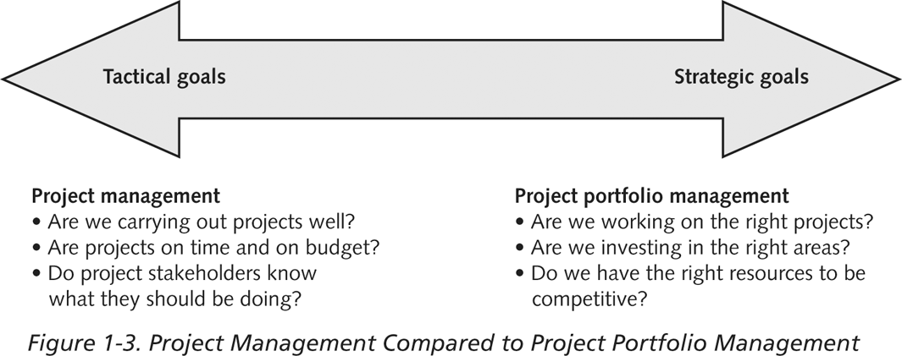
Project Management Compared to Project Portfolio Management

Slide 22
Project management as a profession

Slide 23
A look at Salary Scales in the Philippines (p.1/2)
Average annual salary by job function and years of experience (in PHP)
 | Years of Experience
Job Function | Less than 5 years | 5-10 years | More than 10 years
IT Management | 432,162.00 | 666,000.00 | 691,766.00
Project Management | 501,772.00 | 612,800.00 | 880,000.00
Systems Development | 411,828.00 | 571,500.00 | 548,057.00
Communications | 587,333.00 | 322,833.00 | -
Support | 122,200.00 | 382,333.00 | -
Administration | 326,000.00 | 366,167.00 | -
Other IT Professionals | 175,000.00 | 175,000.00 | -
Overall Average | 376,084.00 | 495,214.00 | 647,251.00

Slide 24
A look at Salary Scales in the Philippines (p.2/2)
Average annual salary by job function and industry (in PHP)
Job Function | IT, Web & Telecom | Government, Education & Health | Legal & Finance | Media, Marketing & Sales (non-IT) | Manufacturing, Services & Others (non-IT) | Overall
IT Management | 695,556.00 | 624,072.00 | 416,000.00 | - | 1,040,000.00 | 664,268.00
Project Management | 538,451.00 | 695,000.00 | 288,575.00 | - | 1,310,000.00 | 602,664.00
Systems Development | 484,965.00 | 472,500.00 | 600,000.00 | 490,500.00 | 200,000.00 | 482,670.00
Communications | 494,125.00 | 364,000.00 | - | - | 390,000.00 | 455,083.00
Support | 292,750.00 | - | 311,250.00 | 163,000.00 | 163,000.00 | 264,091.00
Administration | 292,389.00 | 233,000.00 | 908,000.00 | 360,000.00 | 560,000.00 | 351,821.00
Other IT Professionals | 390,000.00 | 207,500.00 | - | - | 260,000.00 | 307,500.00
Overall | 479,035.00 | 468,086.00 | 447,358.00 | 414,167.00 | 510,750.00 | 472,991.00

Slide 25
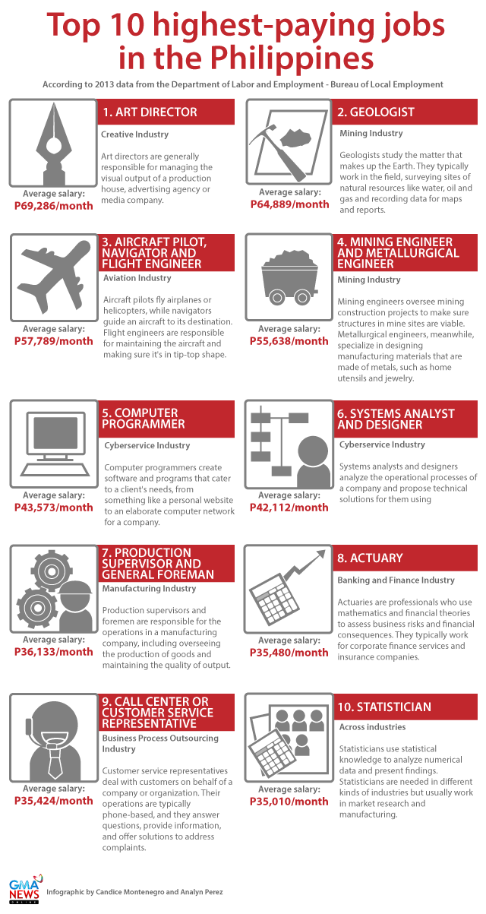
As an addendum

Slide 26
The Project Management Institute
The Project Management Institute (PMI) is an international professional society for project managers founded in 1969
PMI has continued to attract and retain members, reporting 277,221 members worldwide by August 31, 2008
There are specific interest groups in many areas, like engineering, financial services, health care, IT, etc.
Project management research and certification programs continue to grow
Students can join PMI at a reduced fee (see www.pmi.org for details)

Slide 27
Project Management Certification
PMI provides certification as a Project Management Professional (PMP). Overall, a PMP has documented sufficient project experience, agreed to follow a code of ethics, and passed the PMP exam
Certified Associate in PM
Project Management Professional
Program Management Professional
PMI Agile Certified Practitioner
PMI Risk Management Processional
PMI Scheduling Prodessional
Notes:
The Certified Associate in Project Management (CAPM)® is a good entry-level certification if you’re new to project management, or still figuring out your career path.
The Project Management Professional (PMP)® is the most important globally-recognized and independently validated credential for project managers, perfect if you have demonstrated experience and competence in leading project teams.
The Program Management Professional (PgMP)® is designed for those who manage multiple, complex projects to achieve strategic and organizational results.
The PMI Agile Certified Practitioner (PMI-ACP)® is designed for practitioners who utilize Agile approaches to project management in their projects.
The PMI Risk Management Professional (PMI-RMP)® is a specialty credential that demonstrates competence in assessing project risks, mitigating threats and capitalizing on opportunities.
The PMI Scheduling Professional (PMI-SP)® is a specialty credential for practitioners who want to focus on developing and maintaining project schedules.
The OPM3® Professional Certification recognizes your experience with, and practical knowledge of, organization project management and project management maturi

Slide 28
Growth in PMP Certification, 1993-2008

Slide 29
Project success and failure

Slide 30
How do we define project success?
The project met scope, time, and cost goals
The project satisfied the customer/sponsor
The results of the project met its main objective, such as making or saving a certain amount of money, providing a good return on investment, or simply making the sponsors happy

Slide 31
What Helps Projects Succeed?*
1. Executive support
2. User involvement
3. Experienced project
manager
4. Clear business objectives
5. Minimized scope
6. Standard software
infrastructure
7. Firm basic requirements
8. Formal methodology
9. Reliable estimates
10. Other criteria, such as small milestones, proper planning, competent staff, and ownership
*The Standish Group, “Extreme CHAOS,” (2001).

Slide 32
What the Winners Do…
Recent research findings show that companies that excel in project delivery capability:
Use an integrated project management toolbox (use standard/advanced PM tools, lots of templates)
Grow project leaders, emphasizing business and soft skills
Develop a streamlined project delivery process
Measure project health using metrics, like customer satisfaction or return on investment

Slide 33
So there a lot of areas where failure can occur…
Schedule slippage - Resource constraints
Low customer satisfaction - Poor quality
Poor communications - Over budget
Resistance from stakeholders - Uncooperative stakeholders
Lax sponsor - Scope creep
Sponsor terminates project
Regardless of what caused project failure, the project team can always be blamed
So the ball is in your court!
And the single point of accountability for a project is THE PROJECT MANAGER

Slide 34
One Way of Looking at Project Success - Lewis (2000)
Deliverables
met?
Results as
promised?
Expectations
Met?
Outcome
Totally Successful
yes
yes
Political Fallout
no
yes
Political Gratuity
yes
no
Mismatched deliverables at the start
no
yes
Deliverables match weak
yes
no
no
Judged by del only
no
yes
Political Gratuity
no
Totally Failed Project

Slide 35
A note about project management success
Research teams found that organizations achieve significant benefits based on a number of project management variables:
Context: These include economic, individual, cultural , project and organizational attributes.
Implementation: Variables such as training, tools, history, practices and people.
Fit: How customized the process is to the enterprise.
Value: Measures of what actually makes project management worthwhile to a company.
PMI’s Researching the Value of Project Management Study

Slide 36
Lessons Learned (I)
The average team which is diligent will always beat the talented team that procrastinates.
Thoroughly research on the aspect of your project before committing yourself to it.
Whatever happens, members of the team will always have other commitments, may it be personal or business, which will interfere with the project from time to time.
Communication is of utmost importance.
Project disasters happen; make the most of every situation and move on.

Slide 37
Lessons Learned (II)
Ask questions
Sponsors need to be managed
PM is more people than tasks!
PM should never be crammed
Documentation will save you
Importance of contingency plans
Don’t rely too much on sponsorships
Proper goals are important
Accountability
Be familiar with the tasks of other members
Importance of diversity

